Slide 1
August 9, 2021
Telecom churn prediction
Ds programming
Group 8:
Sukeerth Cheruvu
Saiteja Reddy Yerasi
MC Kreps
Neha Dipali

Slide 2
Presentation flow
Introduction
Modeling and Performance Evaluation
Decision Tree
Logistic Regression
Insights and Recommendations
Exploratory Data Analysis

Slide 3

Introduction
Churn:
Customers leaving the service provider
5% retention boosts up to 75% increase in profit
Acquisition 5x - 25x more expensive than retention
Notes:
Neha

Slide 4
dataset
Introduction
Problem statement
IBM Dataset –
Sourced from Kaggle
7,043 records with ~33 variables
Baseline Churn Rate: 26.5%
Predicting Customer Churn
Identifying key variables contributing to Customer Churn
Notes:
Neha

Slide 5
Variable list
Customer Identifiers and Demographics | Region and Location | Telco and Payment Variables | Cross Sale Variables | Churn Variables
CustomerID* | Country* | Tenure Months | Phone Service | Churn Label*
Count* | State* | Contract | Multiple Lines | Churn Value
Gender | City* | Paperless Billing | Internet Service | Churn Score*
Senior Citizen | Zip Code* | Payment Method | Online Security | Churn Reason
Partner | Lat Long* | Monthly Charge | Online Backup
Dependents | Latitude* | Total Charge | Device Protection
 | Longitude* | CLTV** | Tech Support
 |  |  | Streaming TV
 |  |  | Streaming Movies
* Dropped Variable
**Customer Lifetime Value
Notes:
Neha

Slide 6
assumptions
Female
Senior Citizens
Dependents
Cross sale leading to higher engagement
Tech Savvy
Notes:
MC

Slide 7
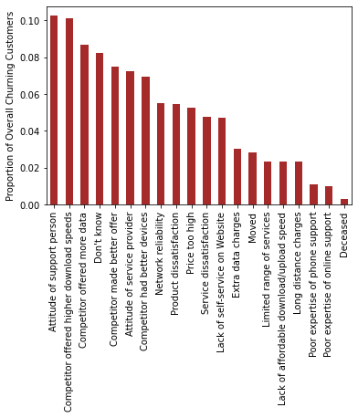
Exploratory data analysis
Notes:
MC

Slide 8
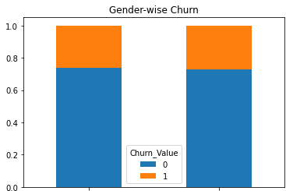
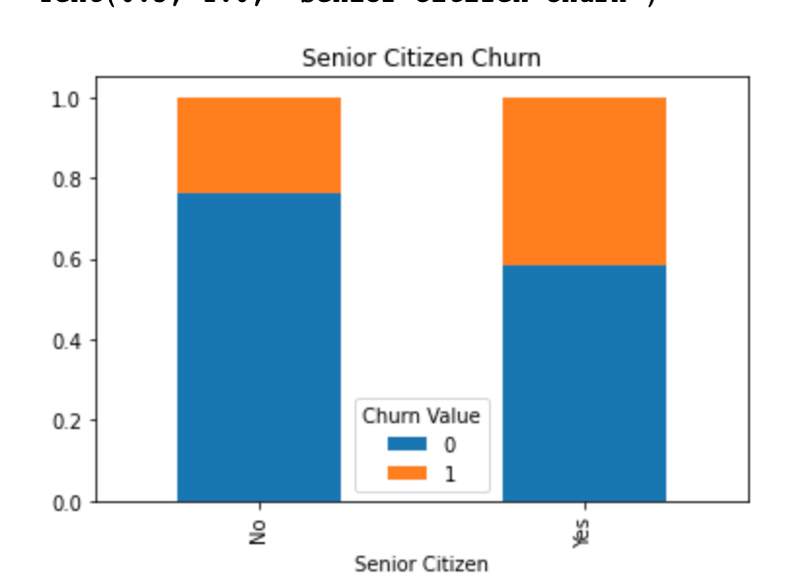
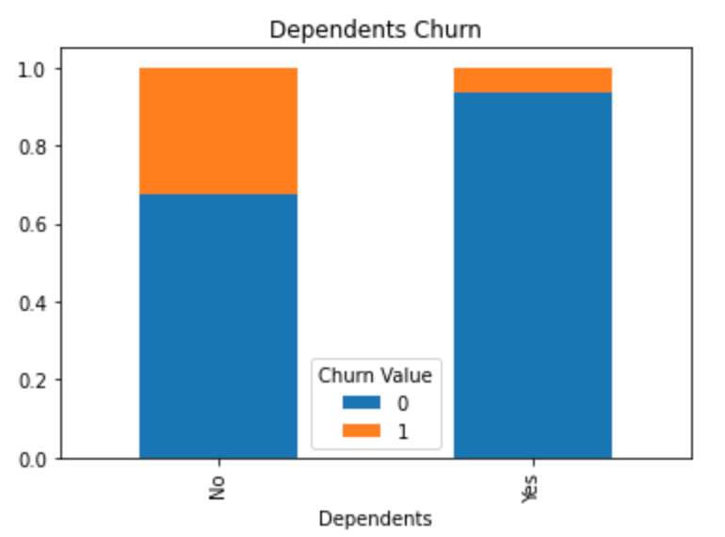
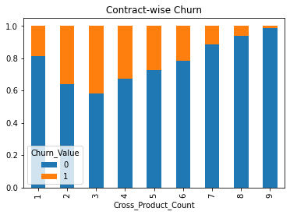
Exploratory data analysis
Male
Female
Non-Senior
Senior
Cross Product Count
Notes:
MC

Slide 9
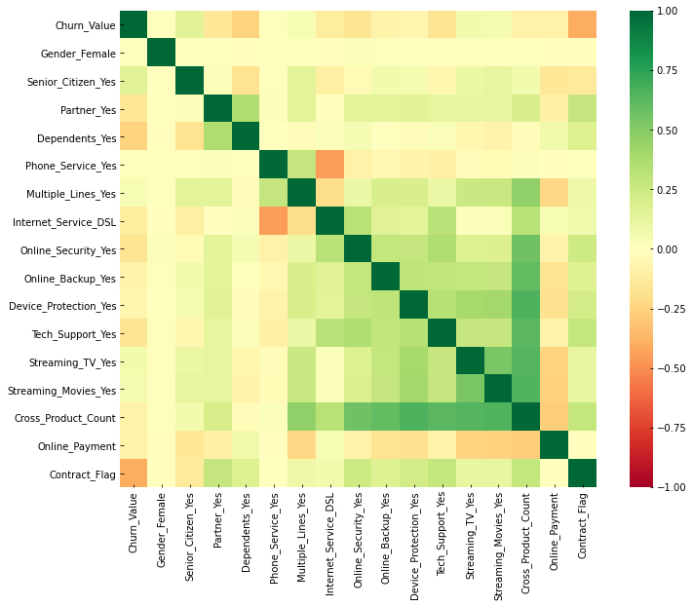
Exploratory data analysis
Notes:
MC

Slide 10
Data wrangling
Removing Variables
Customer identifiers
Redundant features
One Hot Encoding
Yes/No Variables (Cross Sale Variables)
Feature Engineering
Cross Product Count
Duplicate columns
Demographic Variables
Payment Online
Contract Flag
Notes:
Sai

Slide 11
Modeling – decision tree (with 21 variables)
Modeling – decision tree (with 12 variables)
Training Accuracy: 80.10%
Test Accuracy: 78.76%
Precision: 57.05%
Recall: 63.73%
Training Accuracy: 80.25%
Test Accuracy: 78.19%
Precision: 57.5%
Recall: 51.8%
Top 5 features by importance
(after removing the least important variables¹)
Feature | Feature Details | Importance Score
Contract_Flag | Flag – Customer having 1 or 2-year contract | 0.47288
Monthly_Charges | Monthly fixed charges | 0.18774
Tenure_Months | Vintage of customer (months) | 0.14207
Dependents_Yes | Flag – Customer having dependents | 0.10719
Total_Charges | Total charges paid by customer | 0.04793
1. Least important variables removed : Phone Service, Multiple Lines, Internet Service, Online Security, Online Backup, Device Protection, Tech Support, Streaming TV, Streaming Movies
Notes:
Sai

Slide 12
Modeling – logistic regression
Feature | Feature Details | Coefficient
Cross_Product_Count | Count of Cross Products | -0.338736
Dependents_Yes | Flag – Customer having dependents | -0.167364
Contract_Flag | Flag – Customer having 1 or 2 year contract | -0.143892
Online_Payment | Flag - Customers paying the bills online | -0.106654
Tenure_Months | Vintage of customer (months) | -0.079099
Partner_Yes | Flag – If customer has a partner | -0.025636
CLTV | Customer lifetime value | -0.000162
Total_Charges | Total charges paid by customer | 0.000468
Monthly_Charges | Monthly fixed charges | 0.031932
Senior_Citizen_Yes | Flag – If customer is a senior citizen | 0.072459
Paperless_Billing_Yes | Flag – If customer is enrolled in paperless billing | 0.088495
Training Accuracy: 78.92%
Test Accuracy: 79.67%
Precision: 63.87%
Recall: 44.59%
Notes:
Sai

Slide 13
Insights
Churn propensity independent of gender
Senior Citizens have higher churn propensity
People with dependents less likely to churn
Customers with contracts are stickier
Cross products boost engagement and reduce churn
Tech-savvy customers likely to churn
Notes:
Sukeerth

Slide 14
recommendations
Push Contracts
Bundled offers/ Family Plans
Competitiveness
Notes:
Sukeerth

Slide 15
THANK YOU!

